Slide 1
FRUIT PARLOUR
VALLARY ATIENO

Slide 2
TYPES OF FRUITS AVAILABLE
APPLES
ORANGES
MANGO
WATERMELON
PINEAPPLE
BEETROOT
FRESH JUICE
APPLE JUICE
ORANGE JUICE
MANGO JUICE

Slide 3
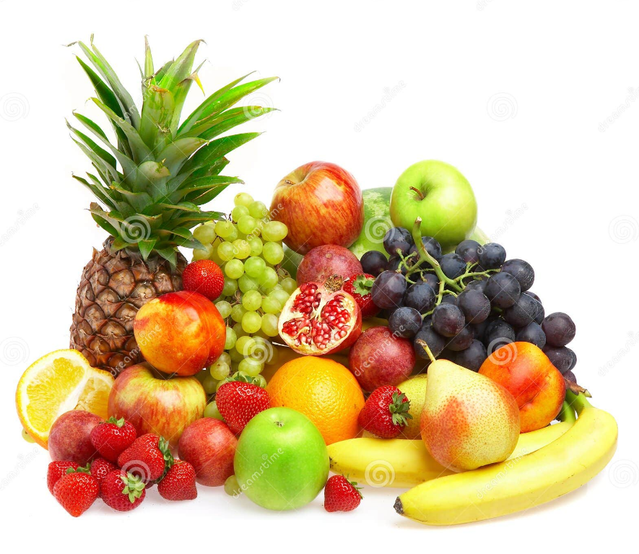
ADVERT POSTER

Slide 4
PRICES
FRUIT | PRICE
APPLE | 45
MANGO | 50
PINEAPPLE | 100
BEETROOT | 80
WATERMELON | 150
ORANGE | 40

Slide 5
SALES PER YEAR

Slide 6
THANK YOU!

